Slide 1
Radiation Dosimetry of Workers During Different Dental Imaging Procedures
Ayesha Arif PH-21003
Dua Arif PH-21043
Hiba Azam PH-21002
Anas Nawaz PH-21068

Slide 2
Problem Identification and Significance
There is no significant research on dental dosimetry for radiation workers. This knowledge gap inhibits the development of guidelines based on evidence for radiation safety in dental imaging.
Dental workers may not receive enough training on radiation safety, dosimetry, and protective measures, which increases the risk of radiation exposure.
Different dental procedures involve varying levels of radiation exposure, and there is limited understanding of these differences. This variability makes it challenging to develop effective radiation safety guidelines.

Slide 3
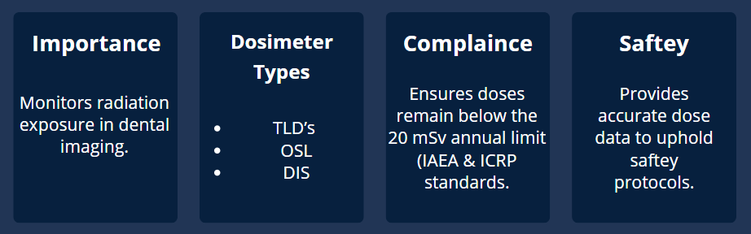
Performing Dosimetry for Dental Workers

Slide 4
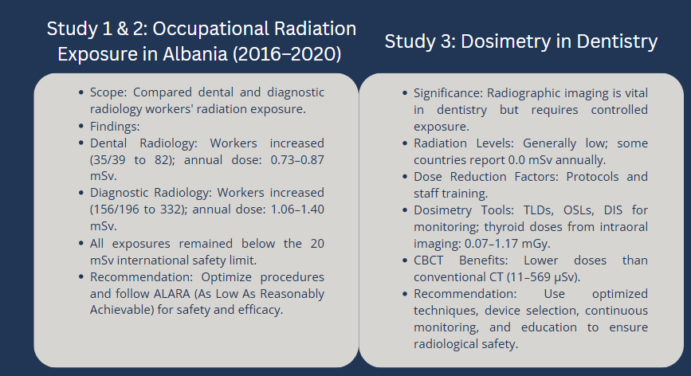
Literature Review

Slide 5
Research Gap
Previous studies on occupational radiation exposure in dental and radiological settings primarily used passive dosimeters like DIS (Direct ion storage), TLD (Thermoluminescent dosimeter), and OSL (Optically stimulated luminescence) for long-term, cumulative dose assessments, often without real-time monitoring or detailed analysis of variables such as angle, distance, kVp, and mA. Statistical analysis in the literature was limited, with little use of predictive models. In contrast, this study used the FS2011+ active dosimeter for real-time monitoring and systematically varied exposure parameters. By applying linear and quadratic regression, it introduced a more detailed, predictive approach to dose analysis, addressing key methodological gaps in existing research.

Slide 6
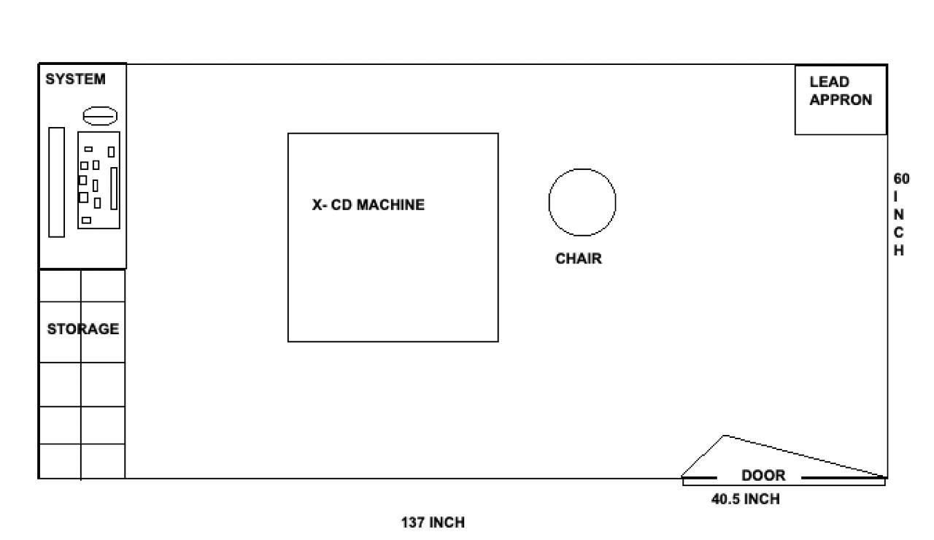
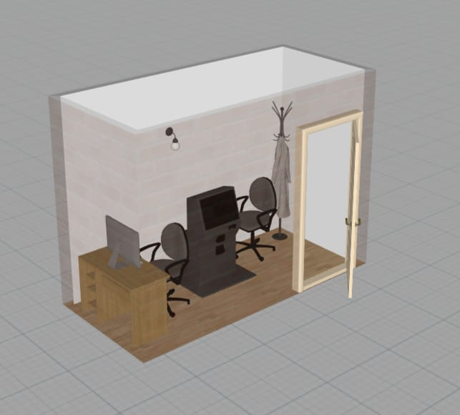
The design shows a layout for a dental X-Ray room optimized for saftey and effective dose management.
DENTAL X-RAY ROOM(DOW UNIVERSITY)

Slide 7
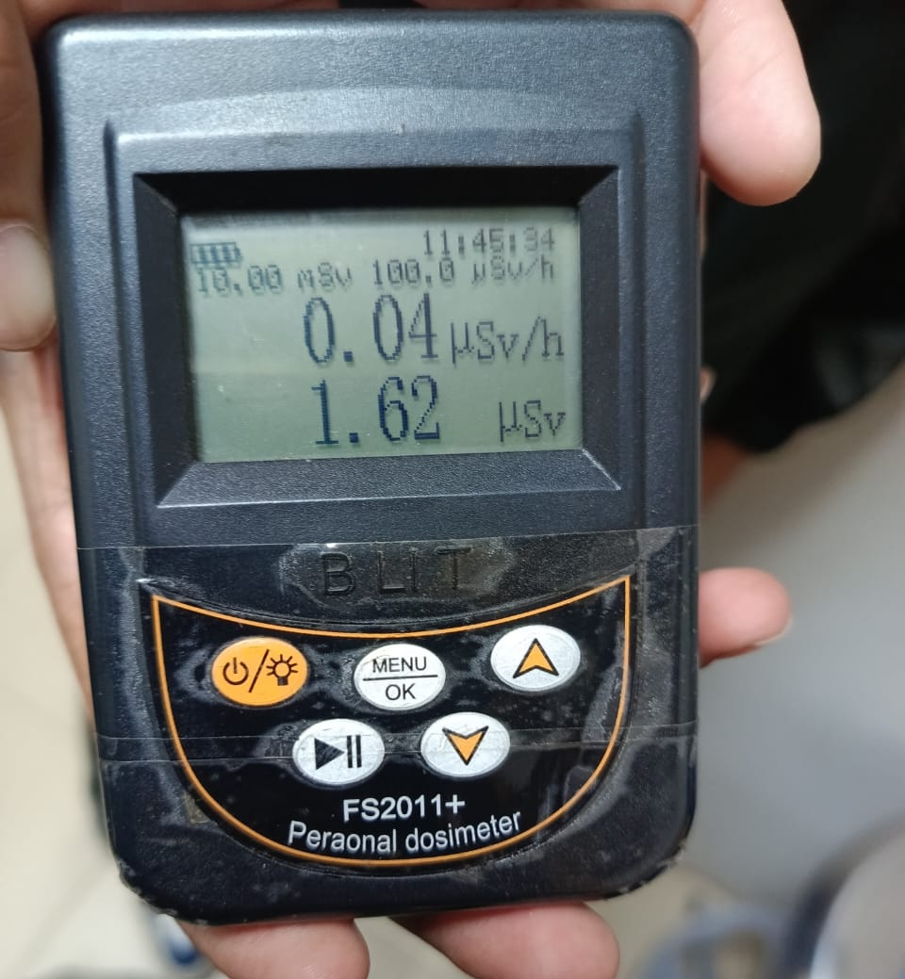
Dosimeters 2011
Radiation Monitoring
Monitoring radiation exposure in dental settings ensures the safety of dental workers. Dosimeters provide accurate and reliable dose measurements.
These devices are calibrated by PINSTECH (Pakistan Institute of Nuclear Science and Technology) to meet international standards, ensuring precise readings in millisieverts (mSv) or microsieverts (μSv) for effective radiation protection.

Slide 8
Dosimeters
Specifications (manual)
Feature | Specification
Radiation types | X, γ, β
Dose‑rate range | 0.01–1,000 μSv/h (up to 10 mSv/h max)
Energy window | ~48 keV–1.5 MeV (±30%)
Accuracy | ±5–15% at 137Cs, 1 mSv/h
Response time | <5 s
Units | μSv/h, μGy/h, mR/h, CPS, CPM
Display | Graphic LCD, backlight, multi-language
Power | 2×AA batteries, low-battery warning
Size / Weight | ~99×69×24 mm; 110–135 g
Operating env. | −10 to +45 °C; ≤95% RH

Slide 9
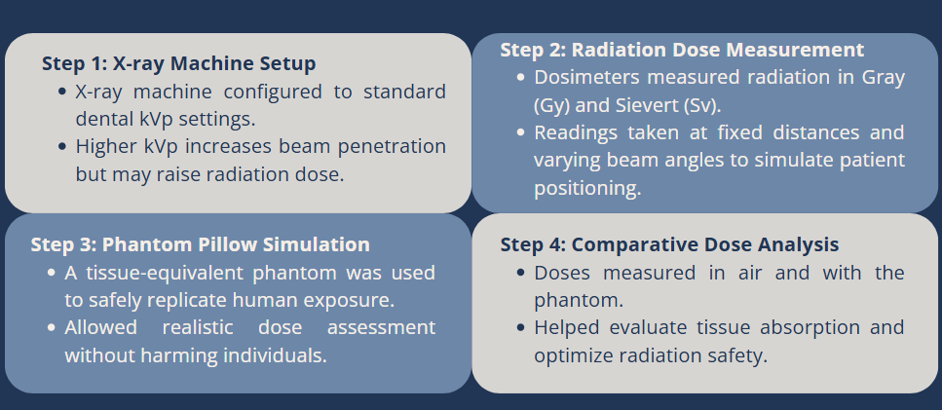
Methodology

Slide 10
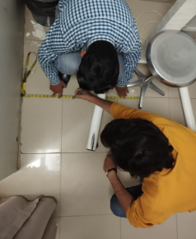
Methodology – Radiation Dose Measurement in Dental Radiography
Objective:
To evaluate variation in radiation dose rate with changes in X-ray settings, angle, and distance— replicating clinical intraoral imaging scenarios.
Exposure Settings Used:
70 kVp, 7 mA (high-energy setup)
60 kVp, 4 mA (routine dental setting)
Measurements Taken:
Angles: 0°, 45°, 90°, 135°, 180°, 215°, 270°, 315°, 360° (full 360° coverage)
Distances: 8", 16", and 24" from X-ray source
Unit: Dose rate in µSv/s (microSieverts per second)

Slide 11
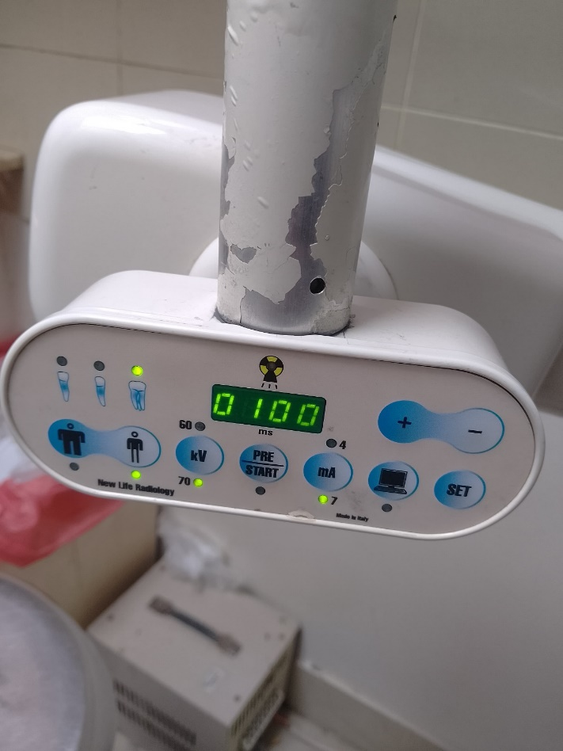
Methodology – Data Collection Process
1. Preparation:
Equipment setup (X-ray machine + survey dosimeter)
Radiation safety checks (e.g., lead aprons)
Initial setting: 70 kVp at 7 mA
2. Measurement Procedure:
Place dosimeter at 0°, 8" from source → take reading
Rotate in 45° increments → take readings up to 360°
Repeat for 16" and 24" distances
Switch to 60 kVp at 4 mA → repeat full angle-distance procedure

Slide 12
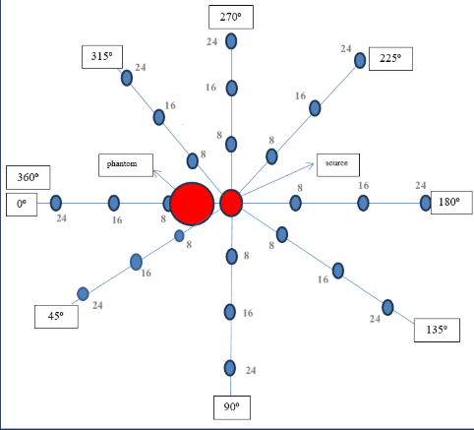
Radiation Dose Distribution Around a Phantom at Varying Angles and Distances

Slide 13
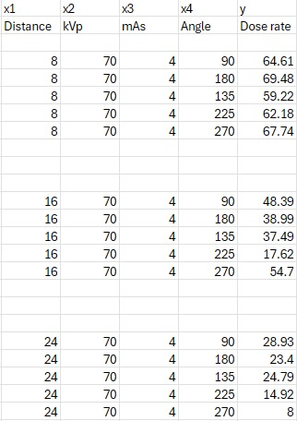
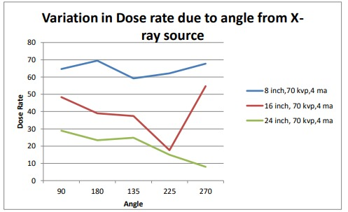
Graphical Analysis
Angular Variation in Dose Rate
(70 kVp, 4 mA)
Radiation dose varies with angle and distance, highlighting beam directionality and environmental influence.

Slide 14
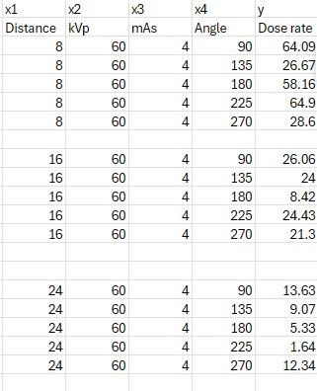
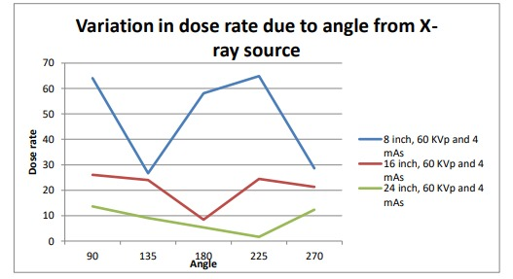
Graphical Analysis
Angular Variation in Dose Rate (60 kVp, 4 mA)
Radiation dose rate varies with angle and distance, showing directional effects and scattering influences.

Slide 15
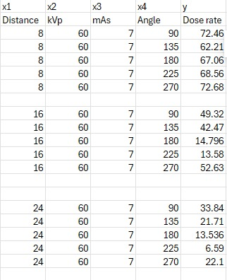
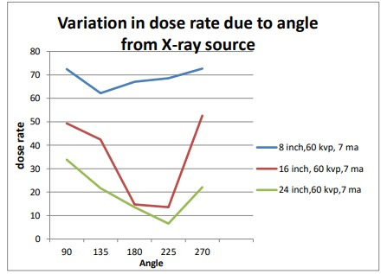
Graphical Analysis
Angular Variation in Dose Rate (60 kVp, 7 mA)
Radiation dose varies with angle and distance, reflecting beam directionality, attenuation, and scattering effects.

Slide 16
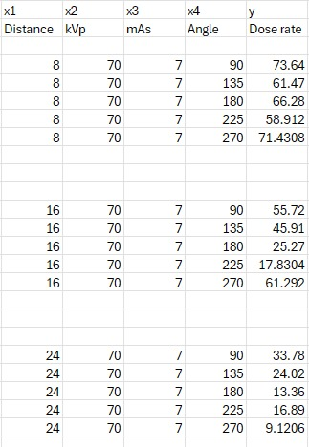
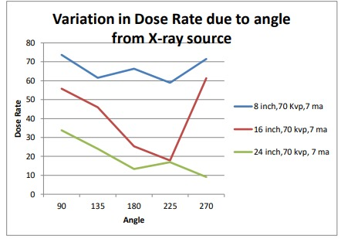
Graphical Analysis
Angular Variation in Dose Rate (70 kVp, 7 mA)
Radiation dose varies with angle and distance, showing directional beam effects, attenuation, and environmental scattering.

Slide 17
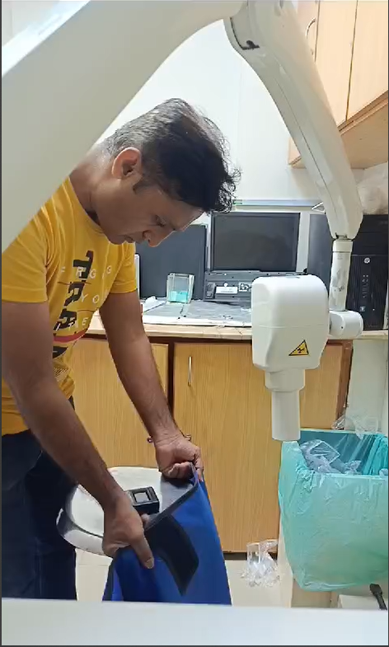
Data Volume, Limitations & Graphical Overview
Dataset Summary:
2 Exposure Settings: 70kVp/7mA and 60kVp/4mA
3 Distances: 8", 16", 24"
9 Angles: 0°–360° in 45° steps
60 combinations per setting → Comprehensive dataset
Limitations:
Linearity Assumption: May fail if relationship isn’t linear
Outliers: Can distort slope/intercept significantly
Graphical Analysis:
Initial step before regression
Helped identify trends, validate physical principles, and detect anomalies

Slide 18
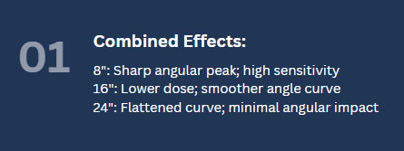
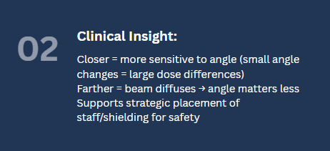
Interaction of Distance and Angle

Slide 19
Comparison of Exposure Settings (70 kVp/7 mA vs. 60 kVp/4 mA)
Higher kVp/mA (70/7) produced 20–50% higher dose rates than lower setting (60/4).
The overall shape of dose vs. distance and angle curves remained consistent.
Indicates geometric radiation behavior is unchanged with different exposure levels.
Suggests models built on one setting may generalize if geometry stays the same.

Slide 20
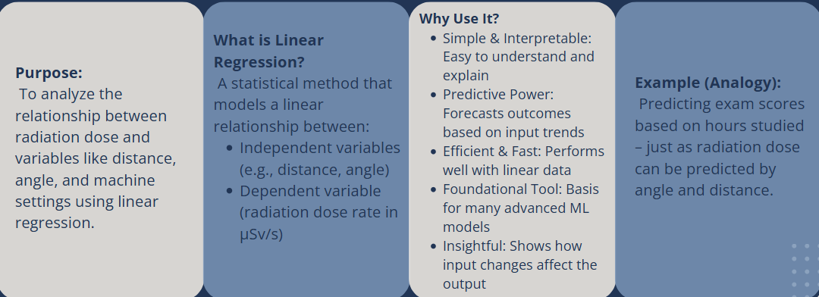
Data Analysis – Linear Regression

Slide 21
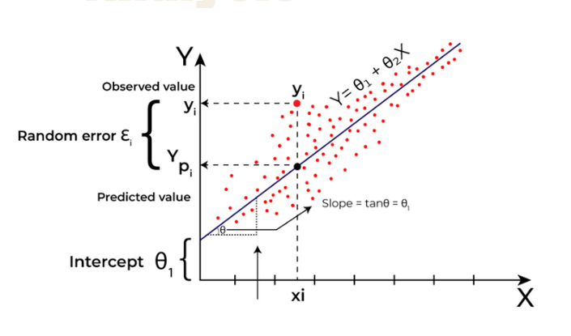
Analysis
Definition:
The best-fit line is a straight line that most accurately represents the relationship between input (X) and output (Y), minimizing the error between actual and predicted values.
Goal:
To reduce prediction errors by minimizing the difference between observed and predicted values.
Equation:
y = mx + b
y: Predicted value (dependent variable)
x: Input (independent variable)
m: Slope (rate of change of y with respect to x)
b: Intercept (value of y when x = 0)

Slide 22
Analysis
Least Squares Method:
Used to determine the best-fit line by minimizing the sum of squared errors (SSE):
SSE = Σ(yi – ŷi)²
yi: Actual value
ŷi: Predicted value
Residual = yi – ŷi
Interpretation:
Slope (m): Change in y for each unit increase in x
Intercept (b): Predicted y when x = 0
Assumption:
Linear regression assumes a linear relationship and other
conditions (e.g., normality, independence) to ensure model
reliability.

Slide 23
Linear Regression Model Setup
Objective: Quantify how kVp, mA, distance, and angle affect dose rate
Dose Rate = β₀ (constant) + β₁(kVp) + β₂(mA) + β₃(Distance) + β₄(Angle)
All variables were numerical; 60 cleaned observations used.
Residuals and R² used to assess model fit and predictive accuracy.

Slide 24
Linear Regression Output and Model Fit
R² = 0.735 → model explains 73.5% of dose rate variation.
Adjusted R² = 0.713; F-statistic = 30.20; p < 0.00000000001.
Root Mean Square Error = 11.76 µSv/s.
Model is statistically significant and reasonably predictive.

Slide 25
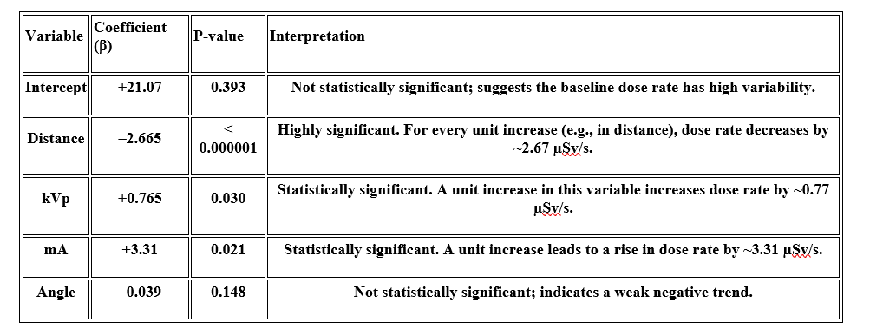
Coefficients and Statistical Significance

Slide 26
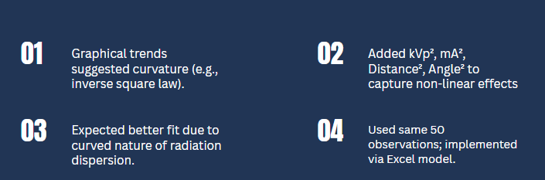
Rationale for Testing Quadratic Regression

Slide 27
Quadratic Model Results and Failure Indicators
R² = –0.174, Adjusted R² = –0.408 → worse than no model.
F-statistic not significant; p > 0.05.
RMSE too high to interpret; model overfit and unreliable.
Model was statistically invalid—worse than mean prediction.

Slide 28
Causes of Quadratic Model Failure
Too many predictors (squared terms) for only 60 observations.
Overfitting: model learned noise, not patterns.
Multicollinearity: linear and squared variables were highly correlated.
Unstable coefficients: angles and distances dominated error.
Measurement noise near background levels also impacted reliability.

Slide 29
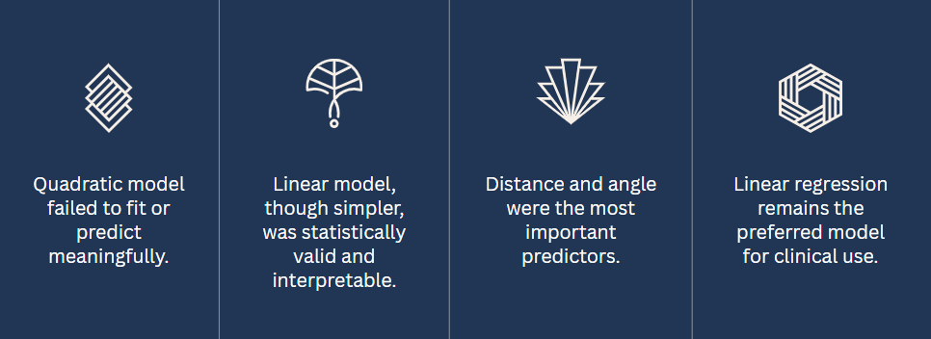
Final Evaluation: Linear vs. Quadratic Model

Slide 30
Model Comparison and Linear Model Strengths
Linear regression explained 73.5% of variance in dose rate (R² = 0.737).
RMSE = 11.76 µSv/s; statistically significant predictors: distance, angle, and kVp.
Aligns with physical laws: – Inverse square law for distance – Positive correlation between kVp and radiation intensity
Strong balance of simplicity, interpretability, and accuracy.
Provided reliable estimates useful for clinical planning and radiation safety.

Slide 31
Quadratic Model Limitations and Final Justification
Quadratic model had negative R² → worse than a flat mean prediction.
Added complexity through squared terms did not improve fit.
Failed due to: – Small sample size vs. number of predictors – Multicollinearity – Overfitting
Predictions deviated sharply from actual data.
Conclusion: Linear model retained as final model due to its robustness, clarity, and clinical relevance.

Slide 32
Final Model Evaluation – Purpose & Methodology
Purpose of Final Evaluation:
Test the practical performance of the linear regression model in real-world dental radiography conditions.
Determine if the model can accurately predict dose rates using new data.
Dataset & Measurement:
Training data included varied kVp, mA, distance, and angle combinations.
All dose measurements taken using a calibrated FS2011+ dosimeter.
Evaluation set used unseen combinations under identical conditions.
Evaluation Process:
Applied the regression formula to evaluation data.
Compared predicted dose rates with actual measured values.
Assessed model using error metrics and prediction accuracy.

Slide 33
Accuracy Assessment of the Model
Comparative Dataset Analysis:
Constructed a side-by-side table of actual vs. predicted dose rates.
Calculated errors between each pair to assess consistency.
What Was Evaluated:
Generalizability of the model to new data.
Model's responsiveness to variations in technical settings and spatial factors.
Key Findings:
Linear model maintained robust accuracy across most test cases.
Demonstrated potential for clinical use in estimating exposure.

Slide 34
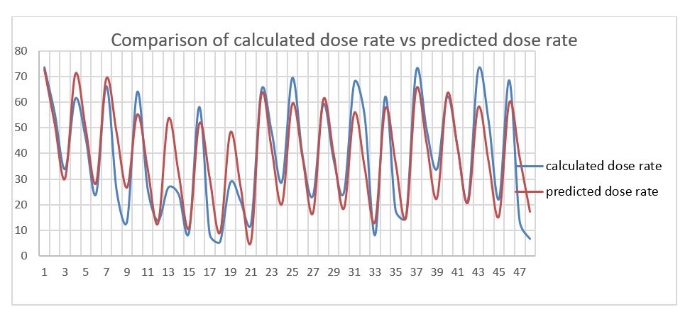
Graphical Comparison – Measured vs Predicted
Visualization Approach:
Created a line graph showing measured vs. predicted dose rates for 48 test cases.
X-axis: each test case (unique kVp, mA, distance, angle).
Y-axis: dose rate in µSv/s.
Graph Behavior:
Both curves showed similar oscillations, reflecting changes in beam angle and distance.
Peaks = positions aligned with the X-ray beam.
Valleys = shielded or peripheral positions.
Interpretation:
Predicted values tracked actual trends well, with only minor deviations.
Model captured real-world variations dynamically, not just averages.
Confirms model’s value for predictive dose assessment in dental settings.
x-axis: Number of Observations
y-axis: Dose Rate

Slide 35
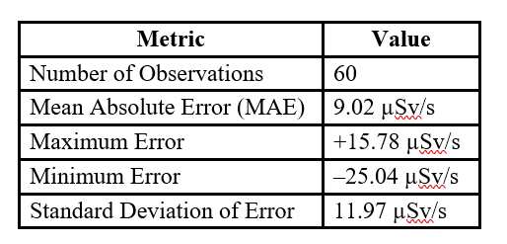
Quantitative Analysis of Prediction Accuracy
Purpose of Analysis:
To measure how closely predicted dose rates matched actual readings.
Interpretation:
MAE is acceptable given measured range (~15–70 µSv/s).
Larger deviations occurred at edge conditions (e.g., uncommon angles/distances).
Consistent trend alignment supports model’s reliability in dental dose estimation.

Slide 36
Error Distribution and Pattern Behavior
Observed Trends in Error:
Underpredictions more common at low-dose conditions (peripheral angles/long distances).
Overpredictions occurred in mid-dose range, likely due to environmental effects.
Graph Analysis Insights:
Predicted and actual curves aligned well but showed small oscillatory offsets.
Model reacted linearly, but real-world data had slight nonlinear fluctuations.
Conclusion:
No consistent bias (errors centered around zero).
Model is balanced and generally accurate, with higher variability in low-dose or transition zones.
Useful for practical applications; future models could benefit from more data or added nonlinearity.

Slide 37
Model Strengths & Weaknesses
Strengths | Weaknesses
Accurately captures trends across distance, angle, kVp, and mA. | Reduced accuracy at low-dose conditions (far distances or peripheral angles).
Easy to interpret: coefficients directly map to real clinical parameters. | Narrow range of mA (4–7 mA) limits generalization.
Balanced error distribution (no consistent over/underestimation). | No nonlinear or interaction terms included.
Clinically acceptable accuracy (MAE: 9.02 µSv/s over 48 cases). | Small dataset (n=50 for training, n=48 for validation).

Slide 38
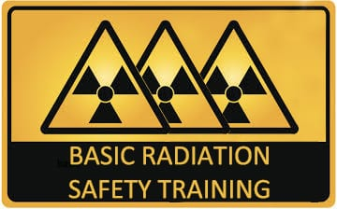
Clinical Use & Safety Impact
Why This Model Matters in Clinics:
Predicts operator exposure without dosimeter for standard settings.
Helps apply ALARA principle in real time.
Aids in strategic shielding placement and technician rotation.
Applications:
Estimate dose at different positions in operatory.
Identify zones of higher radiation for shielding.
Educate staff/students on radiation behavior.
Important Note:
Best used as a supplementary tool, not for high-precision audits.

Slide 39
Final Verdict – Predictive Utility
Conclusion:
Statistically sound and practically useful for quick dose estimations.
Graphical + statistical analysis confirm trend-tracking accuracy.
Adapts well to clinical variables: kVp, mA, distance, and angle.
Maintains reliability even in diverse scenarios, with no strong bias.
Future Improvements:
Larger datasets.
Non-linear models.
Integration with imaging software.
Bottom Line: A simple yet effective model for enhancing safety, awareness, and planning in dental radiography.

Slide 40
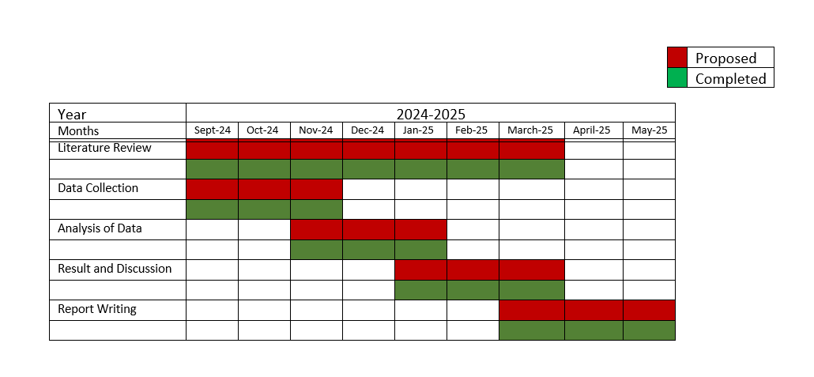

Slide 41
THANKYOU!

